Slide 1
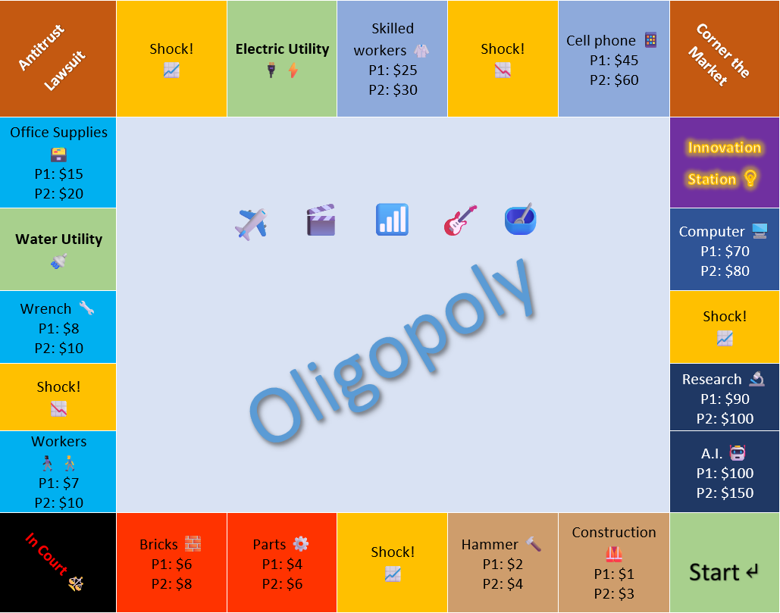
the Board Game

Slide 2



Motivation
Costs
Ben Osenbach (SUNY Poly)
Been teaching introductory micro and Macro for 7+ years
Every time we get to Monopolies in micro, students ask:
Will we get to play Monopoly?
NO!
We have graphs!
$$Pmax$$
$$MR(q_{max})=MC(q_{max})$$
q
$$q_{max}$$

Slide 3
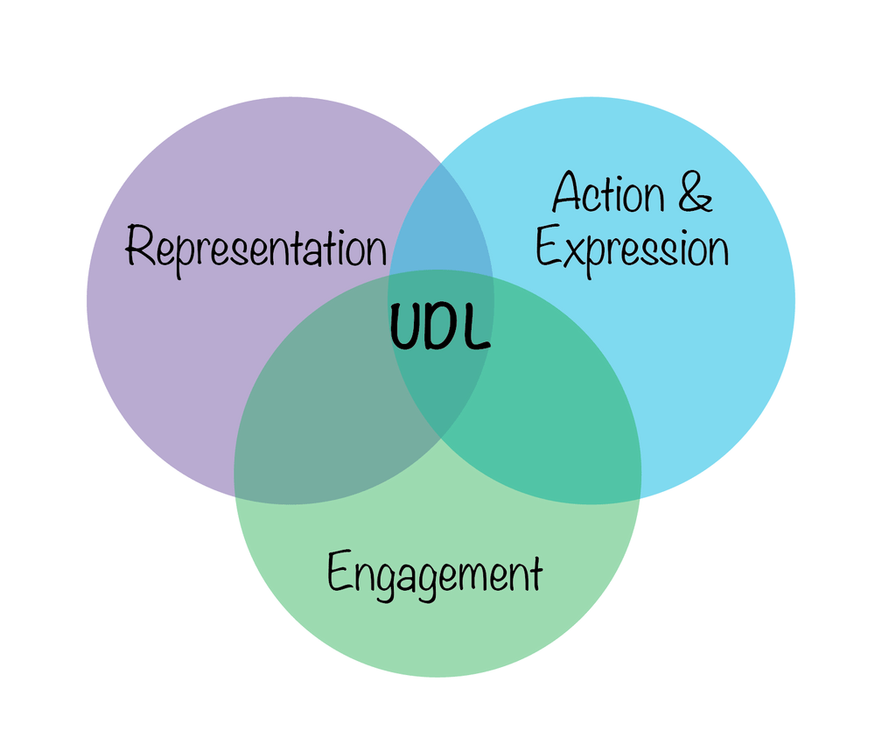
Motivation
UDL = Universal Design for Learning
Idea: do for teaching what accommodations do for people with disabilities
UDL prescribes multiple methods of engagement, representation, and assessment
If you want more students to be engaged, teach with graphs AND SOMETHING ELSE

Slide 4
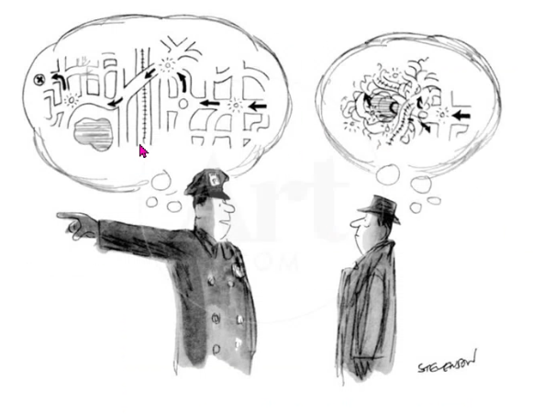
Motivation
Science of Learning (Bill Goffe, 34 RMU)
Learning = building schemas (i.e. “connections between topics”)
Works best when it’s anchored in concrete examples and isn’t stretching working memory
Most students have no reflective experience with price discrimination, treble damages, or antitrust regulations

Slide 5
Oligopoly: the Board Game
Oligopoly: the Board Game (2024)
Patterned after Monopoly®
Game pieces correspond to heavily-oligopolized industries ✈️🎬📶🎸🥣
Slight adaptations for classroom setting
Office® files instead of physical board and pieces (helps online students)
Teams instead of individual players
Multiple dice and synchronous play with rules for conflicts
Game limited to 3 laps around the board

Slide 6
Oligopoly: the Board Game
Rules should teach abstract concepts of imperfect competition
Incentivizes cartels / monopolization
Increasing monopolization also raises the probability of breakdown
Provides concrete illustrations of first-mover advantages
Let’s play!

Slide 7
Oligopoly: the Board Game
Next steps:
All of these resources are simple, accessible Microsoft Office® documents
Hosted in an open-access GitHub repository
Email me (osenbab@sunypoly.edu)
Thank you!

